Slide 1
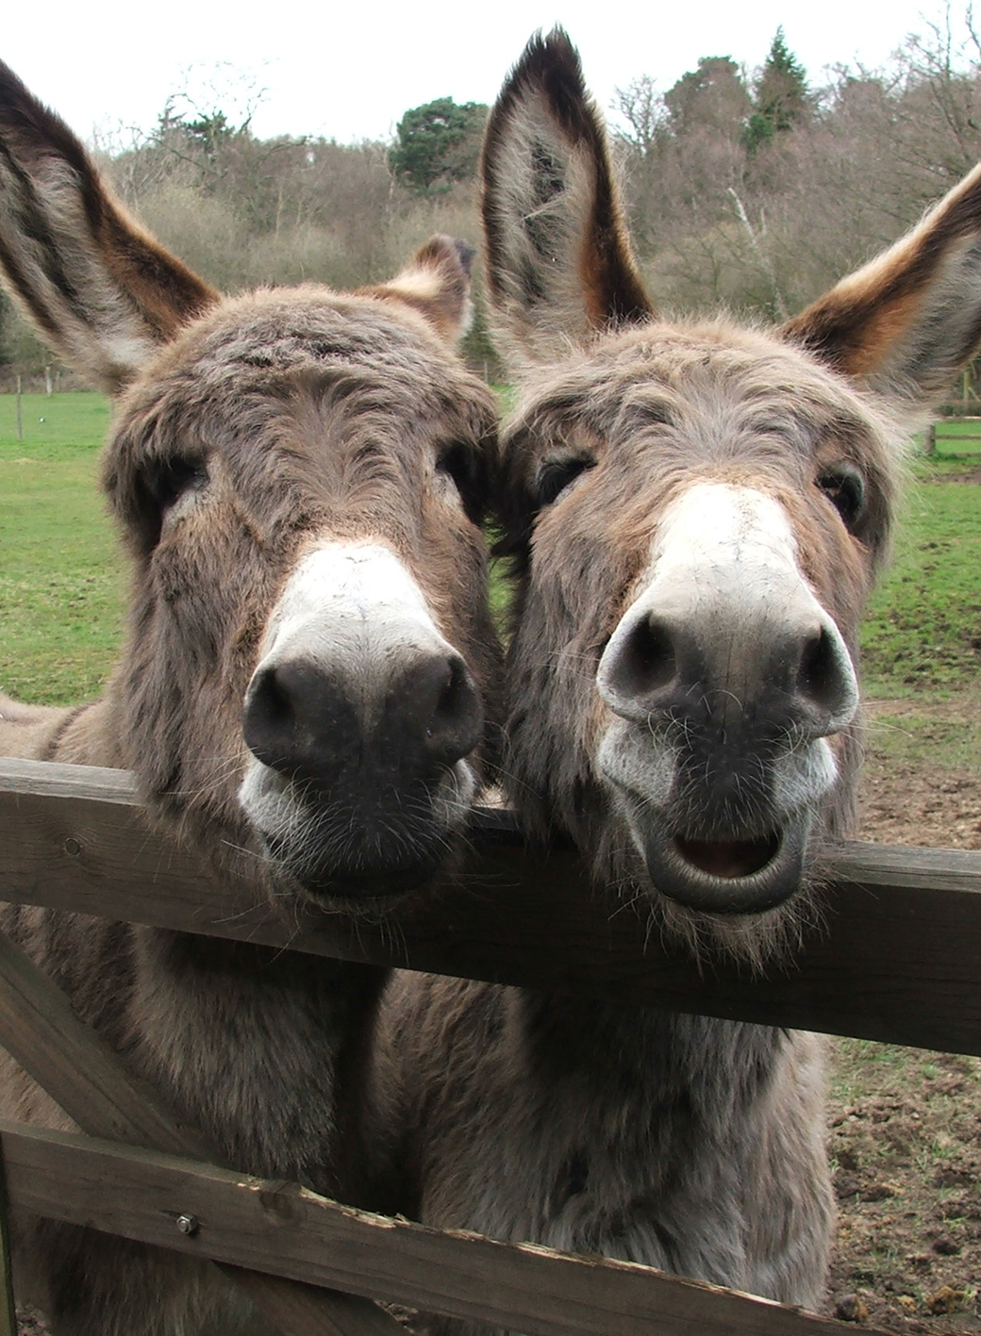
Bible donkeys

Slide 2
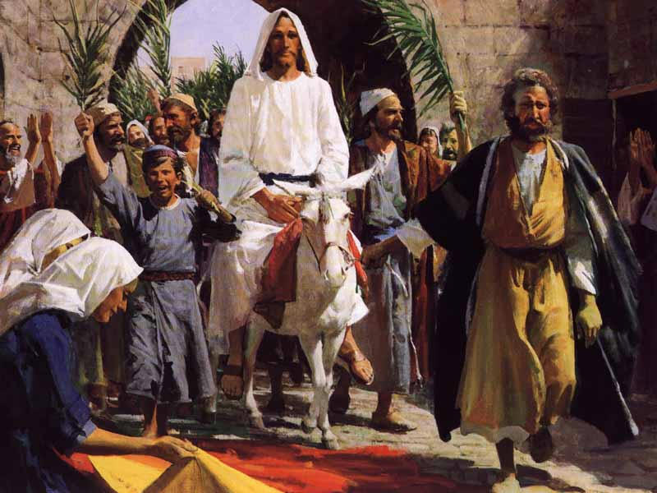
Jesus comes to town
Notes:
As they approached Jerusalem and came to Bethphage on the Mount of Olives, Jesus sent two disciples, ² saying to them, “Go to the village ahead of you, and at once you will find a donkey tied there, with her colt by her. Untie them and bring them to me. ³ If anyone says anything to you, say that the Lord needs them, and he will send them right away.”
⁴ This took place to fulfill what was spoken through the prophet:
⁵ “Say to Daughter Zion, ‘See, your king comes to you, gentle and riding on a donkey, and on a colt, the foal of a donkey.’”^{[a]}
⁶ The disciples went and did as Jesus had instructed them. ⁷ They brought the donkey and the colt and placed their cloaks on them for Jesus to sit on. ⁸ A very large crowd spread their cloaks on the road, while others cut branches from the trees and spread them on the road. ⁹ The crowds that went ahead of him and those that followed shouted,
“Hosanna^{[b]} to the Son of David!”
“Blessed is he who comes in the name of the Lord!”^{[c]}
“Hosanna^{[d]} in the highest heaven!”
¹⁰ When Jesus entered Jerusalem, the whole city was stirred and asked, “Who is this?”
¹¹ The crowds answered, “This is Jesus, the prophet from Nazareth in Galilee.”
NOTE-what is wrong with this picture?

Slide 3
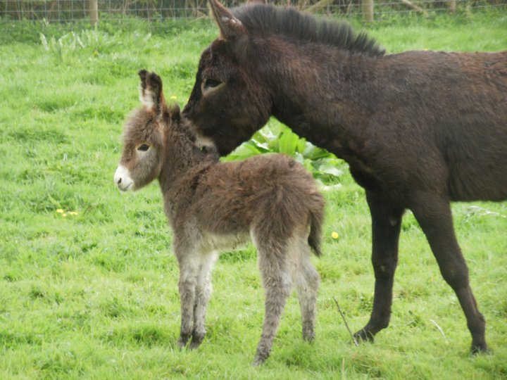
Zechariah 9:9
Notes:
The prophecy was from Zechariah 9:9.
Zechariah was one of the 12 minor prophets in the Bible.

Slide 4
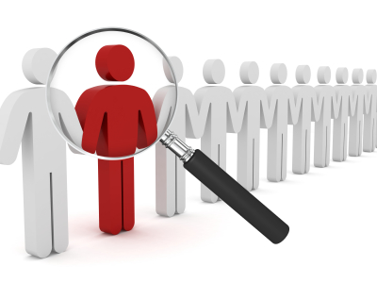
Getting to know Zechariah
Notes:
Name means “Yahweh has remembered”.
Like Zeke last week, he is also part of the Exile.
Book starts off with warning that Yahweh Is very angry and you need to change your ways

Slide 5
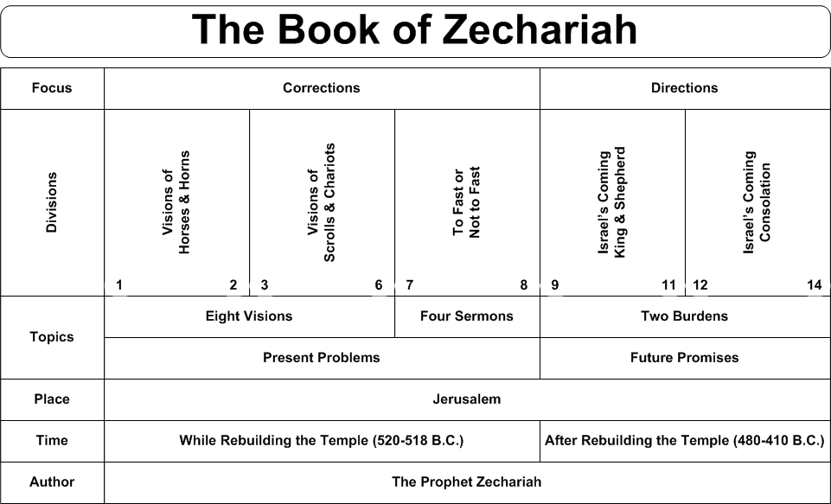
The beginning vision
Notes:
Vision of a man mounted on a red horse with lots of red, brown and white horses.
Asks God but is answered by an angel
You guys were bad but those other guys have gone too far
Angel asks how long to withhold mercy from Jerusalem
Vision of 4 horns
Man with measuring line to measure Jerusalem
Joshua next to an angel next to Satan (adversary)
Joshua shows up in filthy clothes
Zek says put a clean turban on his head
Will bring branch
Gold Lampstand and 2 Olive trees, 7 lamps
Thhis is the word to Zerubbabel –not by might or power but by my spirit
Will finish the Temple
Woman in a Basket taking it with their wings to Bablyon
4 chariots going out in directions to North and West
Crown for Joshua take to build my temple
Justice and Mercy, Not Fasting
Yahweh says Administer true justice; show mercy and compassion to one another. ¹⁰ Do not oppress the widow or the fatherless, the foreigner or the poor. Do not plot evil against each other.’
But people did not listen
Jealousy for Zion (Jerusalem)

Slide 6
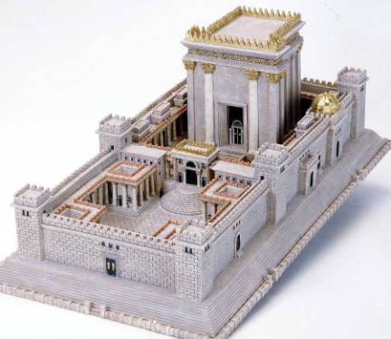
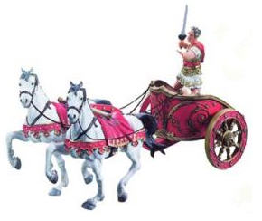
Now in context
Notes:
But I will encamp at my temple to guard it against marauding forces. Never again will an oppressor overrun my people, for now I am keeping watch.
VERSE
I will take away the chariots from Ephraim and the warhorses from Jerusalem, and the battle bow will be broken. He will proclaim peace to the nations. His rule will extend from sea to sea and from the River^{[b]} to the ends of the earth.
Once again interested in Temple
Note that horses are military weapons

Slide 7
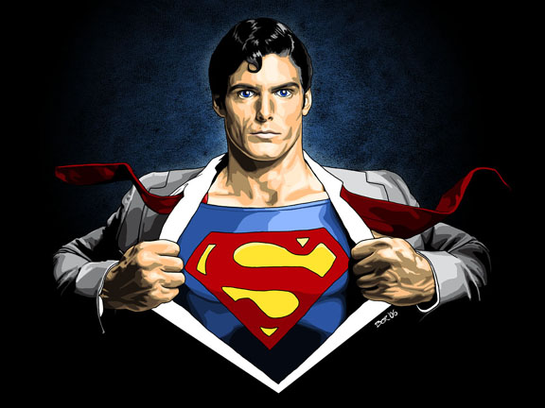
Zak 12 The weak will be strong
Notes:
On that day the Lord will shield those who live in Jerusalem, so that the feeblest among them will be like David, and the house of David will be like God, like the angel of the Lord going before them. ⁹ On that day I will set out to destroy all the nations that attack Jerusalem.
David is kind of the superman of the Early Israelites. He slayed Goliath. (Though this isn’t as a big a deal as really thought- eg Malcomn Gladwell book thesis)
He killed either 700 (Samuel 10:18)
Or 7000 (Chronicles 19:18

Slide 8
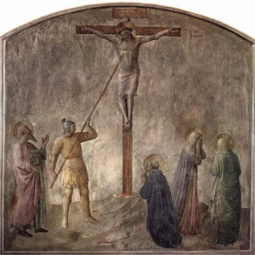
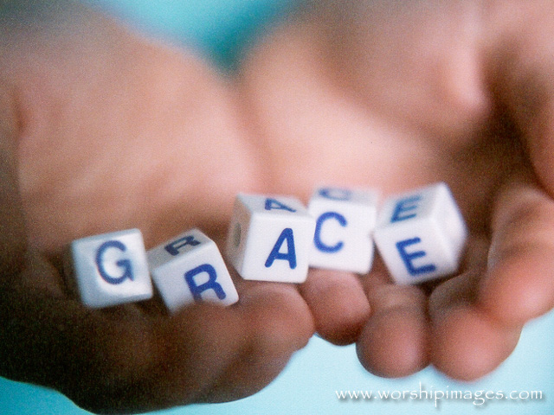
Morning for the pierced one
Notes:
¹⁰ “And I will pour out on the house of David and the inhabitants of Jerusalem a spirit^{[a]} of grace and supplication. They will look on^{[b]} me, the one they have pierced, and they will mourn for him as one mourns for an only child, and grieve bitterly for him as one grieves for a firstborn son.

Slide 9
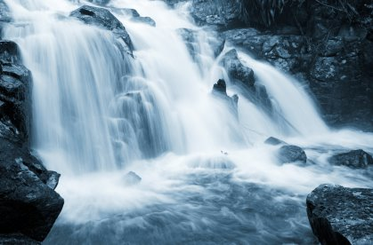
Zak 13
Notes:
“On that day a fountain will be opened to the house of David and the inhabitants of Jerusalem, to cleanse them from sin and impurity.
² “On that day, I will banish the names of the idols from the land, and they will be remembered no more,”

Slide 10
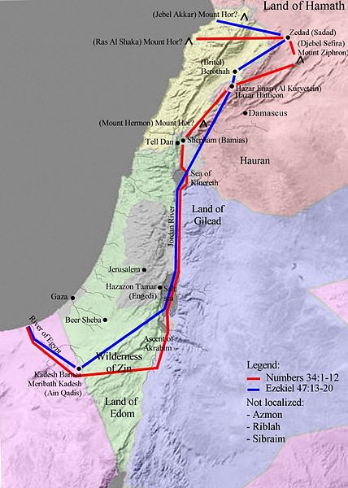
Last Line
Notes:
And on that day there will no longer be a Canaanite^{[c]} in the house of the Lord Almighty.
Phoenica to the west, next to the sea

Slide 11
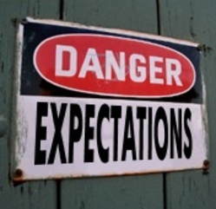
Now you know the story
Notes:
The people of period knew this story.
What do you think the promise of Jesus coming to Jeruselum?
Who are the oppressors at the time of Jesus to the people of Judah?
Notice the Roman come from the West..

Slide 12

Why a donkey?
Notes:
Unlike a horse which is a weaponized animal, a person who is riding a donkey hasn’t any fear.
Kind of I can do it with my hand tied behind my back
I can ride in her on this slow animal and no one can stop me because I am the King

Slide 13
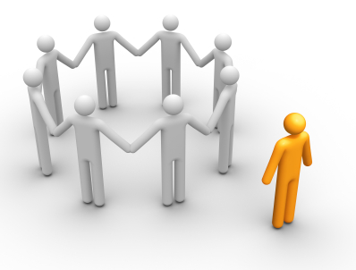
It is different on the outside..
Notes:
Z is an exiled person wanted to come back home and build a Temple
Jesus is also noted as being “from Galilee” and an outsider trying to restore the exiled

Slide 14
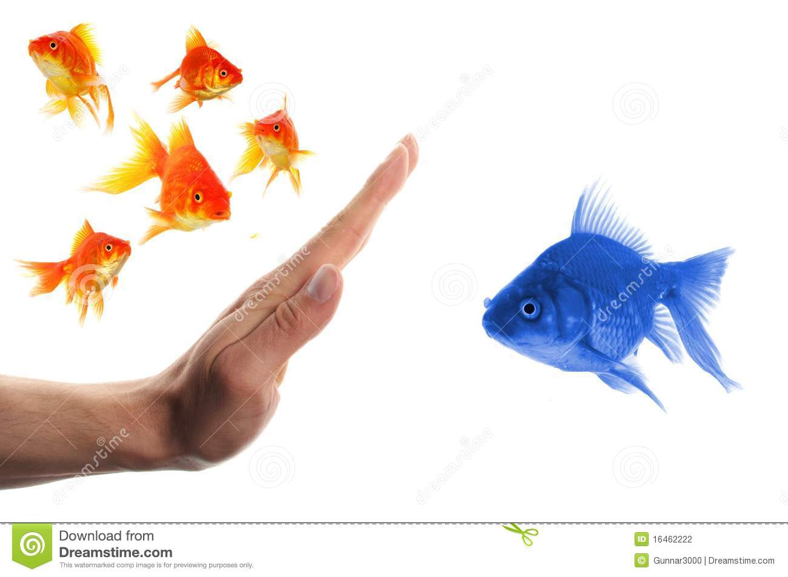
Where do you feel like an outsider?
Notes:
What situations make you feel like an outsider?
School, certain classes, cliques
How do you handle being the outsider?

Slide 15
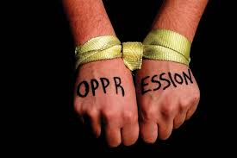
What kind of things oppress us now?
Notes:
This could be you personally or our society at large
What are the last groups that people feel free to leave out?
Disabled, Athiests, Overweight, Migrant workers, mentally ill

Slide 16

How could someone stop these things ?
Notes:
What could be done to stop this outsider feelings or oppression?
What I do to stop oppression
Could a group be more effective than an individual?
What are some of things that the Church and Fire do to stop oppression and practice inclusion?
What would you try to stop first?

